Slide 1
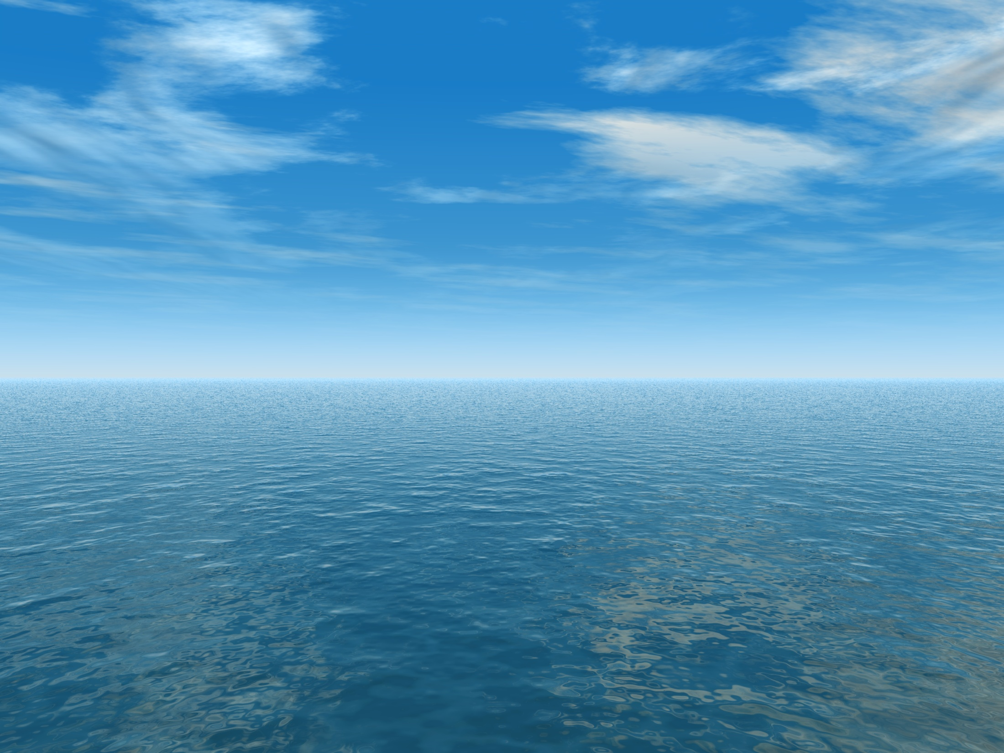
THE AQUANTIS OCEAN-CURRENT TURBINE
RENEWABLE ENERGY FROM MARINE CURRENTS
1/25th Scale Rotor Preliminary Design
March 19, 2013
Henry Swales
Ole Kils
Company Confidential and Proprietary

Slide 2
Conceptual Approach
Re-Design rotor for model scale using hydrofoils designed and tested for tow tank Re# of 168k.
Maintain Froude scaling of thrust, diameter and rotor speed for dynamic stability tests.
Minimize performance instabilities due to laminar separation bubbles.

Slide 3
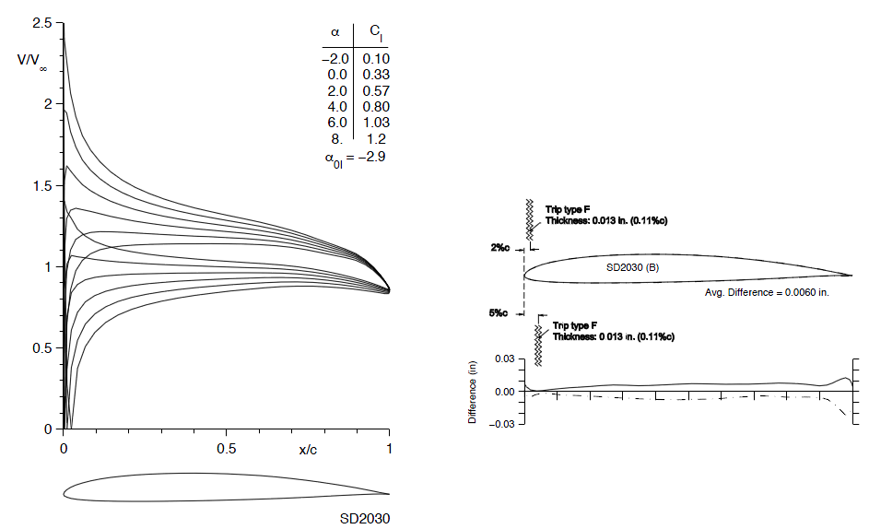
SD2030 Pressure Distributions
Utilize very thin airfoil with long transition ramp developed for low Re# sail planes and wind turbines.
Minimizes laminar separation bubble thickness.
Airfoil Thickness (%) Camber (%) Cm,c/4
SD2030 8.56 2.23 −0.075

Slide 4
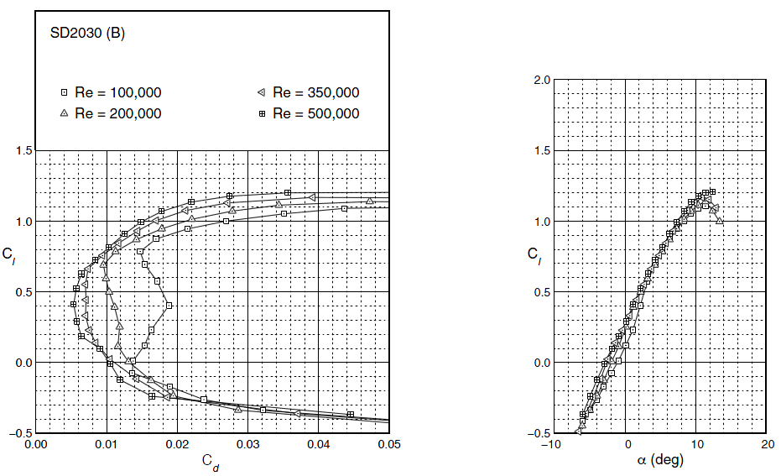
Clean Airfoil Performance
Despite low Re# design, clean airfoil test data still displays some evidence of a laminar separation bubble at Re# = 100k to 200k.

Slide 5
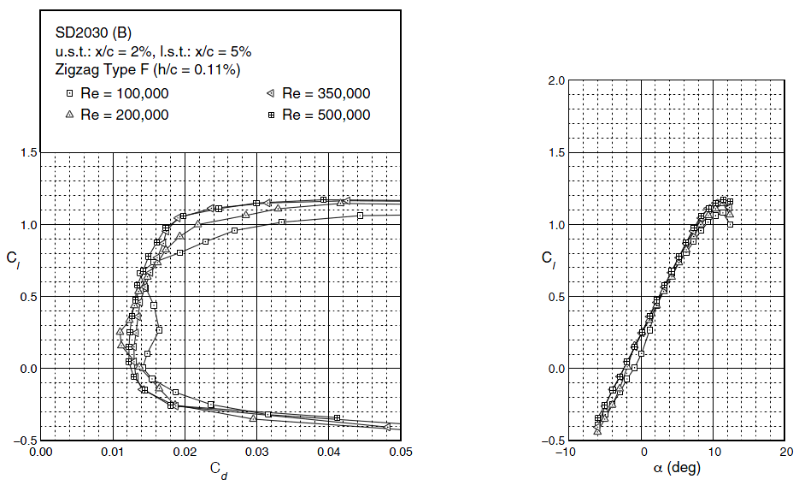
Tripped Airfoil Performance
Test data with a leading edge trip shows minimal laminar separation bubble impact on performance at Re#=100,000.
Tripping the boundary layer is also more representative of the fully turbulent flow regime expected at full scale.
Full Scale Re# @ 0.7R = 10,000,000

Slide 6
Hydrofoil Comparison
Model: SD2030 @ Re# = 100k
Design Point: 4deg
Stall Marin: 8deg
Full Scale: S816 @ Re# = 10M
Design Point: 5deg
Stall Margin: 10deg

Slide 7
Model Design Process
PropID used to optimize chord and twist of all stations for axial induction = 0.342 at 4deg AoA with Rho = 1000 (kg/m^3).
Axial induction increased 2.59% to attain accurate thrust scaling in fresh water.
Re# = 100k test data
Diameter and RPM Froude scaled.
Full Scale reference rotor: 45.5m 30% Thick Estimate ‘Hydro Loop2’

Slide 8
Model Rotor Hydrodynamics
Axial Induction: 0.342
Re#: 168k
Design Cl: 0.65

Slide 9
Performance Comparison
Similar performance at design point:
Model Cp: 0.428
Full scale Cp: 0.425

Slide 10
Reynolds Number Calibration
Airfoil A = 100k Re#
Airfoil B = 200k Re#
Blended Airfoil = 168k Re#

Slide 11
Design Point (TSR = 8) Comparisons
Rotor thrust scales very well at the design TSR
0.6% difference – well within test accuracy.
Rotor Torque: 2.7% difference
Root Bending Moment: 3.1% difference

Slide 12
Off-Design Comparisons (1.9m/s)
TSR=6 is minimum computed with test data.
Lower values use Viterna flat-plate approximation.
Thrust diverges from scaled values at TSR above design point.
Only test cases that experience TSR above 8.0 are hydraulic failures.
Differences in off-design performance result from hydrofoil, Re#, and AoA differences.
See next slide and previous hydrofoil polar data plots.
May be able to adjust blade pitch or TSR to improve thrust accuracy for off-design cases based on results of captured test.

Slide 13
Blade Element Data
Difference in Cl drives discrepancy in high-TSR axial induction and rotor thrust.

Slide 14
Additional Analysis
Cavitation Check
Min. Cavitation Number: 4.7
TSR=14.5, Flow Speed: 0.5m/s, Hub Depth: 2m
Cp_{min} estimated to be ~ -4.0 at Cl_{max}
verify with Xfoil analysis
Off-Design TSR
Viterna flat-plate post-stall
Start-up Torque w/o pitch control
Viterna Flat-Plate Post-Stall Estimation

Slide 15
Scaled Blade Design
Model Blade Design Requirements:
Pitch adjustability of +-0.5deg.
Trailing edge thickness of ~0.1mm.
Ability to operate in submerged environment.
Mass and CG to be evaluated for inertial match.

Slide 16
Scaled Blade Design
Extreme Loads Design Point
TSR 8.000
Rotor Speed 41.975 RPM
Flow Speed 0.500 m/s
Pitch -1.504 deg
Diameter 1.820 m
# | r/R | Relm (m) | Twist (deg) | Chord (m) | Relative Thickness (t/c %) | Absolute Thickness (m) | Thr/Len (N/m) | Trq/Len (N)
 |  | 0 |  | 0 | 100% | 0.092
1 | 0.050 | 0.046 | 23.553 | 0.092 | 100.00% | 0.092 | 9.1 | 0.365
2 | 0.150 | 0.137 | 23.553 | 0.155 | 40.00% | 0.062 | 37.5 | 2.784
3 | 0.250 | 0.228 | 15.078 | 0.218 | 8.56% | 0.0186608 | 79.3 | 5.23
4 | 0.350 | 0.319 | 10.558 | 0.167 | 8.56% | 0.0142952 | 111.0 | 7.286
5 | 0.450 | 0.41 | 7.833 | 0.134 | 8.56% | 0.0114704 | 142.7 | 9.173
6 | 0.550 | 0.501 | 6.032 | 0.111 | 8.56% | 0.0095016 | 174.1 | 10.904
7 | 0.650 | 0.592 | 4.758 | 0.094 | 8.56% | 0.0080464 | 204.4 | 12.438
8 | 0.750 | 0.683 | 3.812 | 0.08 | 8.56% | 0.006848 | 230.6 | 13.608
9 | 0.850 | 0.774 | 3.083 | 0.066 | 8.56% | 0.0056496 | 242.7 | 13.763
10 | 0.950 | 0.865 | 2.503 | 0.042 | 8.56% | 0.0035952 | 192.1 | 10.44

Slide 17
Scaled Blade Design

Slide 18
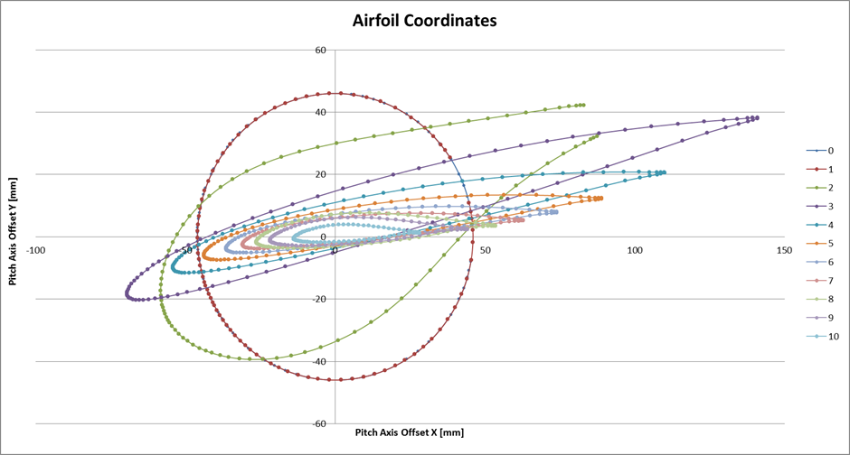
Scaled Blade Design – Proposed Structure
Rapid Prototyping with Watershed XC11122
ABS-Like Properties
2650 MPa Tensile Modulus
47.1 MPa min Tensile Strength (ASTM D638)
Max root moment of 76 N-m
Very thin airfoil for hydrodynamic scaling 8.56%
Initial calculations show ABS-type material is feasible
Working with rapid prototype company to assess manufacturing feasibility and costs.

Slide 19
Scaled Blade Design – Proposed Structure
Basic structural analysis performed for strain analysis
Assumes no twist in calculation
Assumes principal axes of airfoil are aligned with chord line.
Material safety factor of 1.35
Tip deflection calculation pending
Detailed 3D model pending

Slide 20
Scaled Blade Design – Pitch Adjustment
Considerations for adjustable pitch
Easy manual adjustment of pitch +-2deg with intervals of +-.5deg desired
Sleeve connection of root envisioned with 9 tapered axial holes for insertion of alignment pins.
Next Steps
Define manufacturing plan
Detailed 3D sectional stress analysis
Root connection and pitch adjustment design

Slide 21
Next Steps
Resolve high-TSR thrust discrepancy
3D Effects
Rotational Inertia
Root Attachment
Pitch adjustment
Loft

